Slide 1
LINQ and Lambda Expressions

Slide 2
What is LINQ?
List Integrated Query
A SQL-like extension in C# that allows for querying enumerables.
Two ways of using LINQ
Query Syntax
Method Syntax
Both ways are identical, and produce identical results
Just written differently

Slide 3
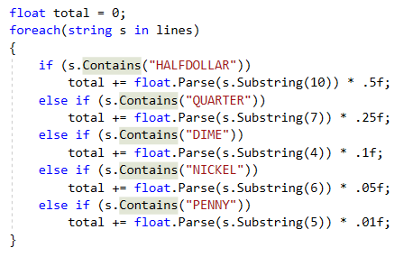
Code without LINQ
From debugging assignment.
Read from file values of currency and determine overall amount.

Slide 4
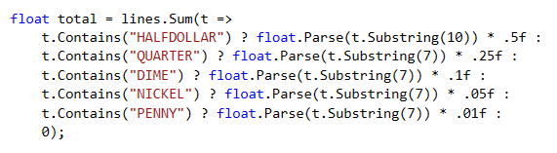
Method Syntax (My preferred)

Slide 5
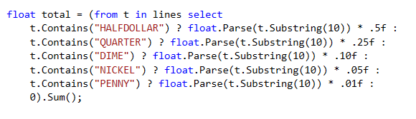
Query Syntax

Slide 6
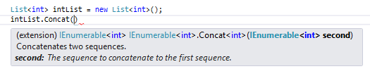

Syntax (IEnumerable)

Slide 7
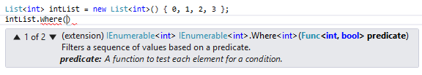

Syntax (Func)

Slide 8
Projection and Restriction Methods
Select, SelectMany, Where
Join & Grouping Methods
GroupJoin, Join, GroupBy
Set Methods
All, Any, Contains, Concat, Distinct, Except, Intersect, Union
Ordering Methods
OrderBy, OrderByDescending, ThenBy, ThenByDescending, Reverse
Aggregate Methods
Aggregate, Average, Max, Min, Sum
Paging Methods
ElementAt, First, Last, Take, TakeWhile

Slide 9
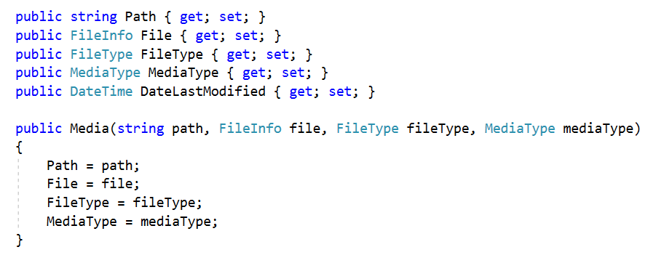
Referenced in slides

Slide 10
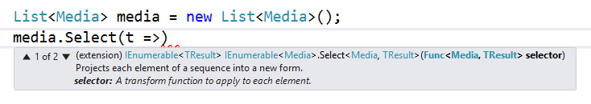


.Select(Func)
Select can return any type (even anonymous types!)
Often times used with keyword “var”

Slide 11
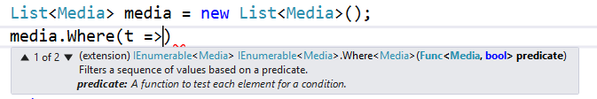

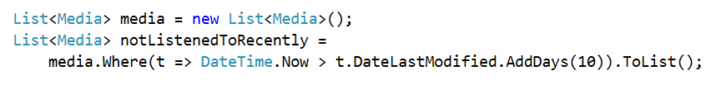
.Where(Func)
Where returns a subset of a given collection that satisfy the given conditional statement.

Slide 12
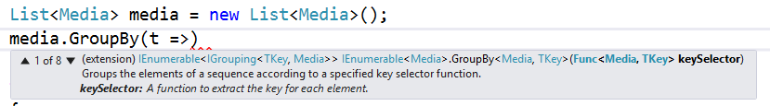
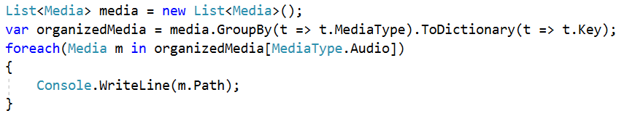
.GroupBy(Func)
GroupBy groups collections by a given key (and more)
https://docs.microsoft.com/en-us/dotnet/api/system.linq.enumerable.groupby?view=netframework-4.7.2

Slide 13
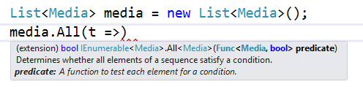

.All(Func)
All returns whether or not every element satisfies a condition
Notes:
Example: If all of your homework assignments are turned in, you don’t have to take the final.

Slide 14
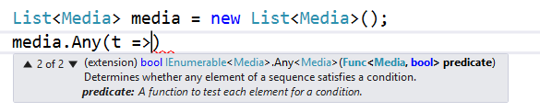
.Any(Func)
Any returns if at least one element is satisfied

Slide 15
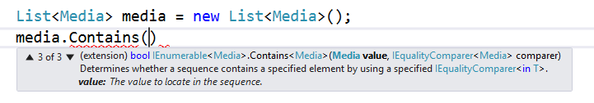
.Contains(obj, comparer)
Contains checks to see if the collection contains an item
If no comparer given, default is used.
https://docs.microsoft.com/en-us/dotnet/api/system.linq.enumerable.contains?view=netframework-4.7.2

Slide 16
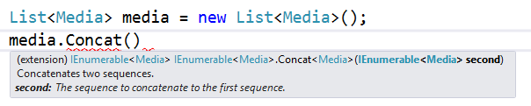
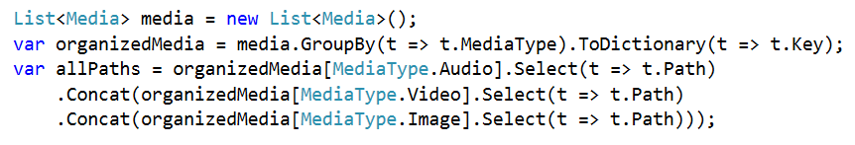
.Concat(IEnumerable)
Puts one enumerable after the other

Slide 17
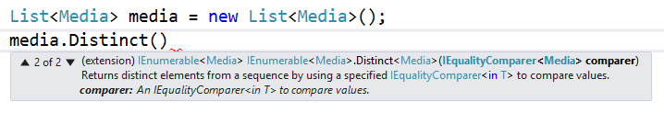
.Distinct(comparer)
Removes all duplicates
If no comparer is given, default is used

Slide 18
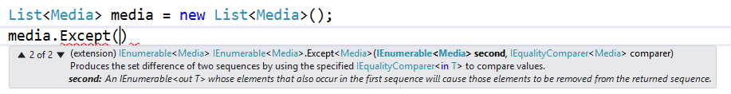

.Except(enumerable, comparer)
Take all of the collection, except for what is in other collection
If no comparer is given, default is used

Slide 19
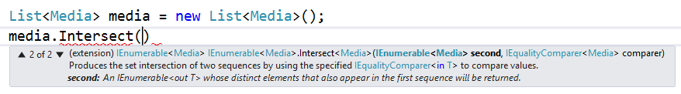

.Intersect(enumerable, comparer)
Intersects two collections (data that is in both collections)
If no comparer is given, default is used
*No good (obvious) examples of Media intersections that aren’t overly complicated

Slide 20
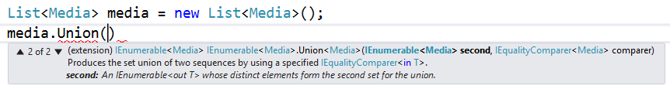
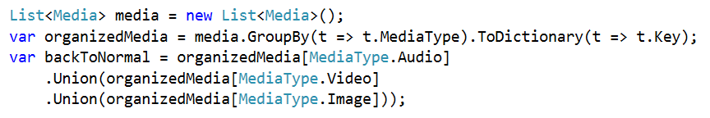
.Union(enumerable, comparer)
Unions the two collections (concats them, no duplicates)
If no comparer is given, default is used
* Note that Concat would do exactly the same function. Union difference is that if there is a duplicate, it only takes one.

Slide 21
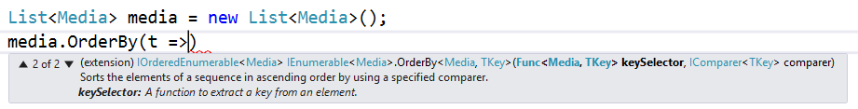


.OrderBy & .OrderByDescending(func)
Orders based on the func
If no comparer is given, default is used

Slide 22
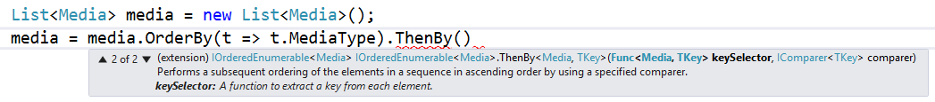

.ThenBy & .ThenByDescending(func)
Orders based on the func. Only usable after OrderBy
If no comparer is given, default is used

Slide 23
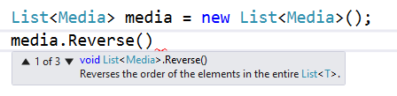
.Reverse()
Reverses the order of the collection
*No good (obvious) examples of Media reverses that are interesting

Slide 24
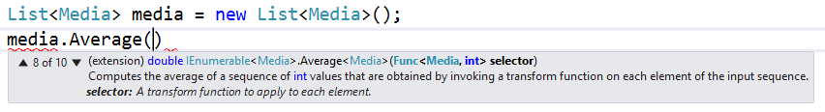
.Average(func)
Averages the values of a collection based on selector

Slide 25
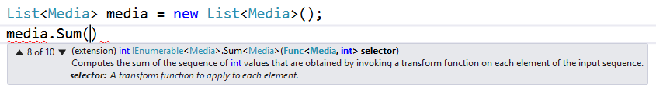
.Sum(func)
Sums the values of a collection based on selector
*No good (obvious) examples of summing Media that is interesting

Slide 26
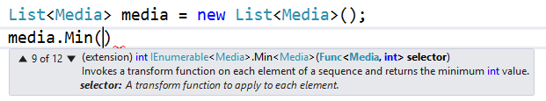

.Min(func) & .Max(func)
Returns the min/max of a collection

Slide 27
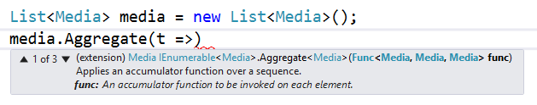
.Aggregate(func)
Useful for finding “the best” of the collection

Slide 28
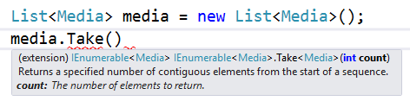

.Take(int)
Take the first int number of elements in the collection
If less than int elements in collection, does not crash.

Slide 29
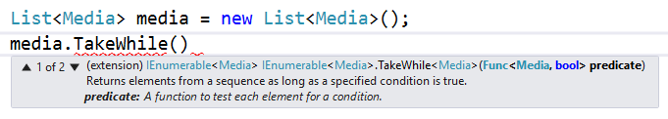
.TakeWhile(func)
Takes elements from beginning of collection until condition returns false.

Slide 30
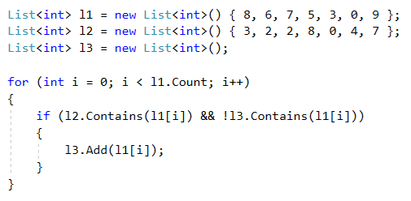
Lab pt. 1

Slide 31
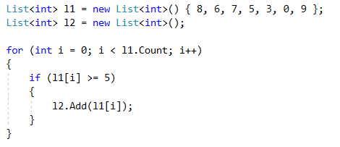
Lab pt. 2

Slide 32
HW 5 pt. 1
Using various LINQ methods, develop a problem that you would otherwise do with for loops or other techniques that you have learned.
Solve this problem with those original techniques and LINQ (so solve it twice) and submit it on Canvas.
I will choose a selection of these and compile them into a single program for HW 5 pt. 2
Be creative!

Slide 33
Delegates
A delegate is very similar to a function pointer in C/C++
Think of it as a variable that holds a method.
Can be used in many ways, but most often used for events.
AI Example

Slide 34
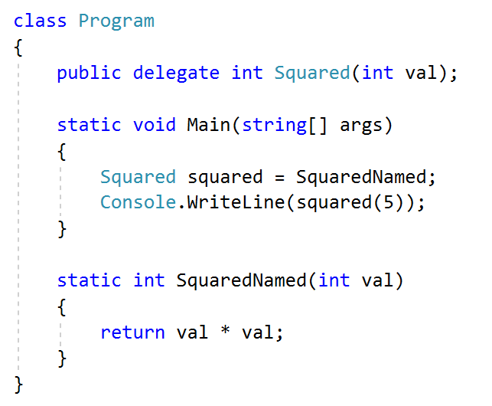
Delegates using named methods

Slide 35
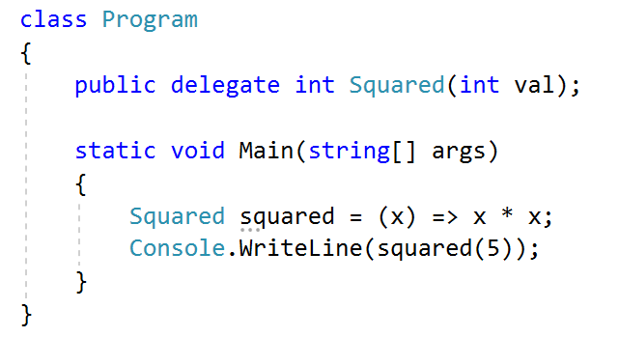
Delegates using anonymous methods

Slide 36
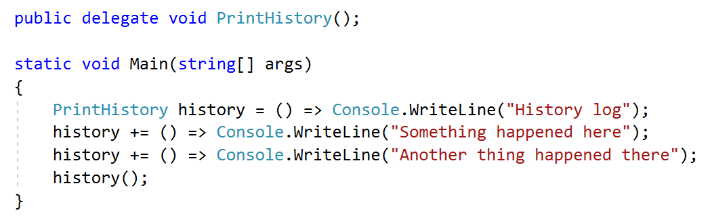
Delegate Multicasting
Delegates can have multiple methods assigned to them.
The code below is inefficient, but is a decent example.
Just use a string builder instead.

Slide 37
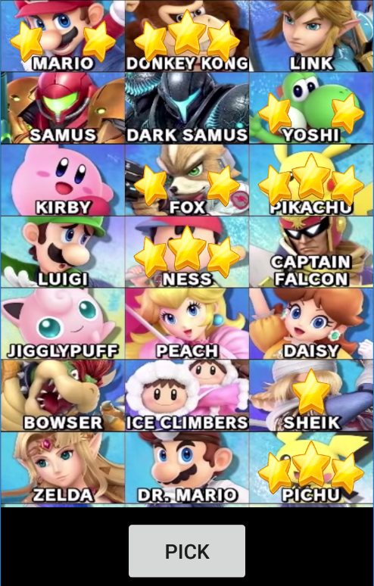
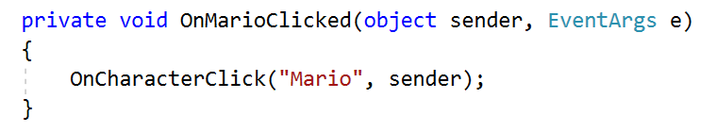
Real Example
Last semester I made a simple mobile app to help demonstrate to students effective ways of pitching their ideas.
This app had 74 buttons that did the same exact function call, with a different argument for each.

Slide 38
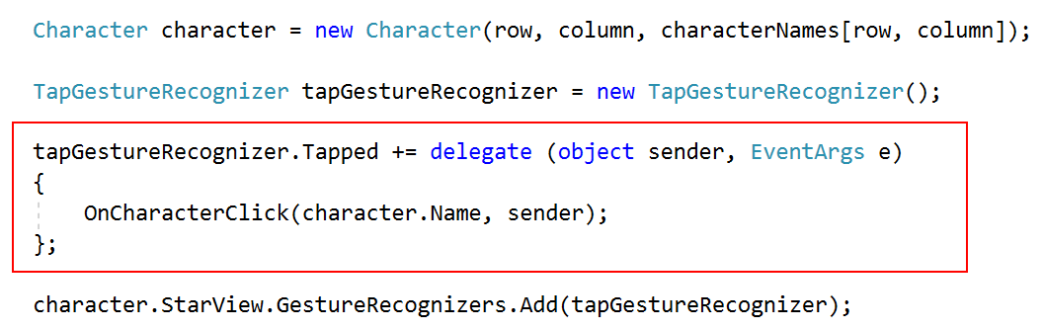
Simple solution
The code below is in a for loop that iterates over all characters

Slide 39
Lambda Expressions
Anonymous Methods
Types
Expression
Statement
Async (will discuss when we get to asynchronous programming)

Slide 40
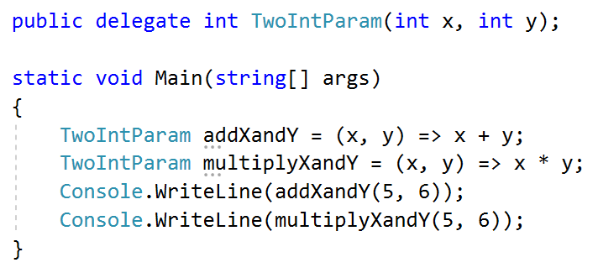
Expression Lambdas
What was used in the LINQ examples.
Signified by expression on right side of the => operator.

Slide 41
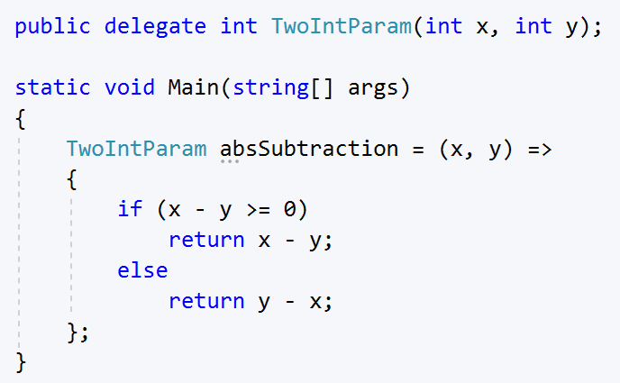
Statement Lambdas
Signified by statement on right side of => operator surrounded by { }.

Slide 42
Taking LINQ too far
Horrifying example
https://projecteuler.net/problem=4

Slide 43
Lab
https://projecteuler.net/archives
Navigate for interesting problems and develop a solution using LINQ.
If you consider your problem interesting enough, submit it for HW 5 pt.1 (remember, you can submit more than 1 problem).

